Slide 1



THE ROLE OF PHYSIOTHERAPISTS
IN MEETING SUSTAINABLE DEVELOPMENT GOALS AND DELIVERING SUSTAINABLE CLINICAL PRACTICE
EUROPE REGION OF WORLD PHYSIOTHERAPY
FOLLOW US!

Slide 2

Physiotherapists Meeting SDGs
and Delivering Sustainable Clinical Practice
Healthcare is a major contributor to global emissions, largely due to healthcare supply chains and hospital care.
Healthcare systems must respond to and mitigate the effects of climate change.
Sustainable clinical practice contributes to a reduction in overall healthcare emissions.
Physiotherapy services and practices support an opportunity towards more sustainable healthcare and sustainable clinical practice.
Five Principles. One Goal. Physiotherapy contributes to Sustainable Healthcare.

Slide 3
Physiotherapists contribute to Sustainable Clinical Practice and Sustainable Healthcare
What is sustainable healthcare ?
Healthcare that meets the needs of our populations, without damaging the health or ability to meet the healthcare needs of vulnerable people now or in the future.
Why is it important for YOU to take action ?
The global climate and nature crisis is a health crisis – and healthcare is part of the problem.
Physiotherapists can maximise positive patient health outcomes, reduce inequity while at the same time minimising negative environmental, social and financial impacts.
Sustainable development goals related terminology (2024), Europe Region of World Physiotherapy.
Five Principles. One Goal. Physiotherapy contributes to Sustainable Healthcare.

Slide 4

Physiotherapists Meeting SDGs
and Delivering Sustainable Clinical Practice
Earth Overshoot day is 5 June 2026
This day marks the point when humanity's demand on nature exceeds what the earth can regenerate in a year, indicating we are using resources faster than they can be replenished.
If everyone on Earth lived at the same level of consumption as the residents of that particular country.
What is your country’s overshoot day?

Slide 5
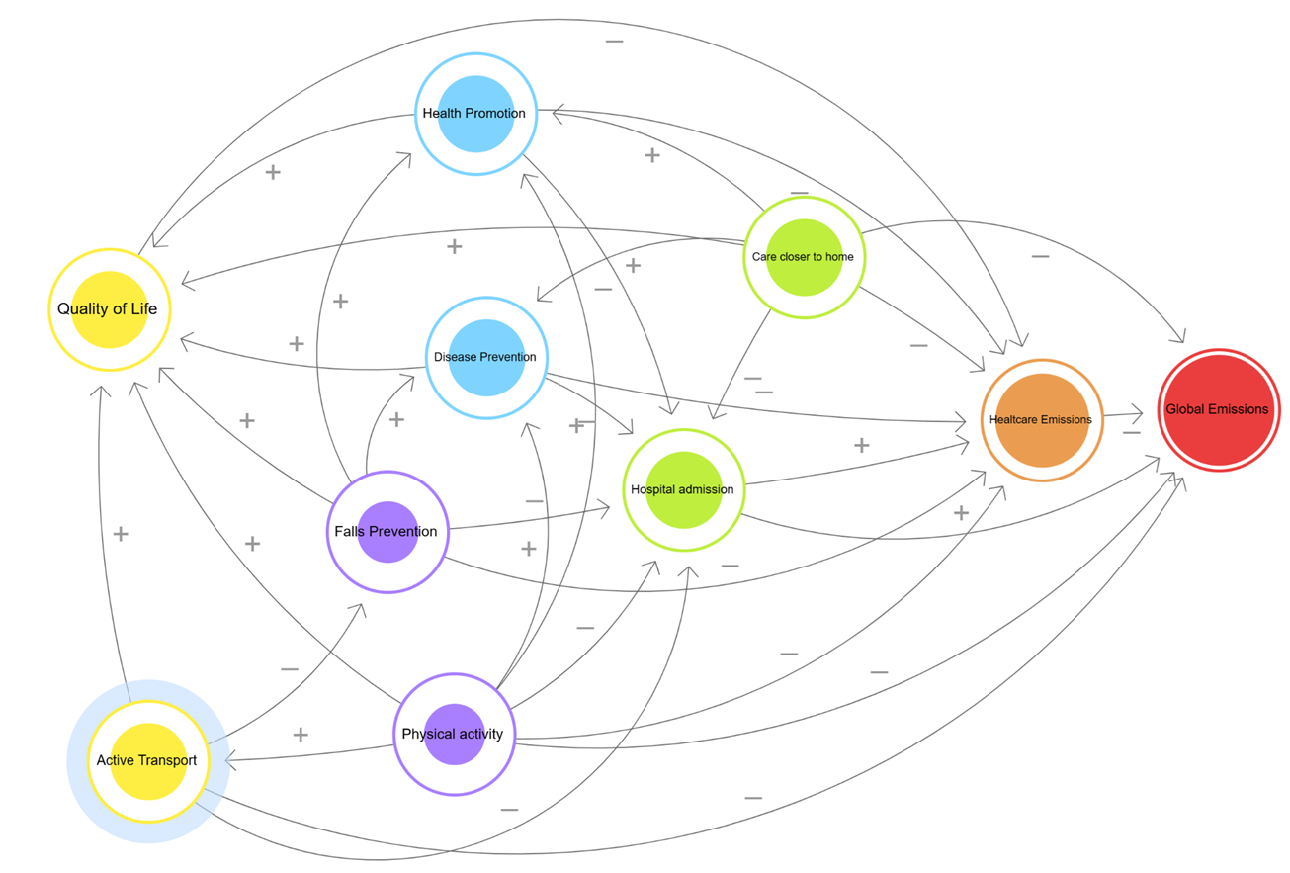
Physiotherapists Meeting SDGs
and Delivering Sustainable Clinical Practice

Slide 6





Physiotherapists Meeting SDGs
and Delivering Sustainable Clinical Practice
Promoting health, preventing disease and tackling the cause of illness and inequalities. The most sustainable healthcare is that which is never needed.
#1
Prevention
Empowering citizens to take a greater role in managing their own health and healthcare.
Educating to manage health conditions.
#2
Patient Empowerment and Self-care
Streamlining care systems to minimise wasteful activities.
Five Principles. One Goal. Physiotherapy contributes to Sustainable Healthcare.
#3
Lean Service Delivery
Taking account of the carbon footprint of services when selecting, delivering or improving services.
#4
Low Carbon Alternatives
Efficient using of energy, transport, water, waste and equipment.
#5
Efficient Resource Use

Slide 7
Physiotherapists Meeting SDGs
and Delivering Sustainable Clinical Practice
#1
Prevention
#2
Patient Empowerment and Self-care
#3
Lean Service Delivery
#4
Low Carbon Alternatives
#5
Efficient Resource Use
600,000 physiotherapists in Europe means there is huge potential to adopt and grow further sustainable practices that could reduce the carbon footprint in Europe.
Physiotherapists must understand the environmental impact of care provided and decisions made.
Five Principles. One Goal. Physiotherapy contributes to Sustainable Healthcare.

Slide 8
Physiotherapists Meeting SDGs
and Delivering Sustainable Clinical Practice
#1
Prevention
#2
Patient Empowerment and Self-care
#3
Lean Service Delivery
#4
Low Carbon Alternatives
#5
Efficient Resource Use
Physiotherapists can:
  Assume a leadership role in embedding sustainability in practice.
  Promote the environmental impact of clinical decisions.
  Drive climate conscious practice.
  Incorporate sustainability into workplace induction and everyday practice.
Five Principles. One Goal. Physiotherapy contributes to Sustainable Healthcare.

Slide 9
Physiotherapists Meeting SDGs
and Delivering Sustainable Clinical Practice
5 Principles. One Goal
Prevention
Promoting health, preventing disease and tackling the cause of illness and inequalities.
The best way to improve patient care whilst reducing emissions is to prevent illness.
Physiotherapists in primary care have a key role in disease prevention.
Prevention approaches result in both improved health and environmental outcomes.
The most sustainable healthcare is that which is never needed.
#1
Prevention

Slide 10
Physiotherapists Meeting SDGs
and Delivering Sustainable Clinical Practice
5 Principles. One Goal
Patient Empowerment and Self-care
Empowering citizens to take a greater role in managing their own health and healthcare.
Self-care empowers patients to make informed decisions about their health, leading to improved outcomes and more efficient healthcare.
Physiotherapists educate patients to manage health conditions, improve health awareness and facilitate patient-centred decision making.
#2
Patient Empowerment and Self-care

Slide 11
Physiotherapists Meeting SDGs
and Delivering Sustainable Clinical Practice
5 Principles. One Goal
Lean Service Delivery
Streamlining care systems to minimise wasteful activities.
Early intervention to reduce overall healthcare consumption.
Clear and appropriate diagnosis, careful consideration of appropriate investigations and treatment to avoid duplication of care, reduce hospital attendance and eliminate wasteful practices.
#3
Lean Service Delivery

Slide 12
Physiotherapists Meeting SDGs
and Delivering Sustainable Clinical Practice
5 Principles. One Goal
Low Carbon Alternatives
Physiotherapy has a relatively lower carbon footprint compared to other clinical fields with its emphasis on the promotion of active healthy lifestyles, health promotion, patient centred care, delivering services closer to home and minimum equipment use.
Take account of the carbon footprint of services when selecting, delivering or improving services.
#4
Low Carbon Alternatives

Slide 13
Physiotherapists Meeting SDGs
and Delivering Sustainable Clinical Practice
5 Principles. One Goal
Efficient Resource Use
Efficient management of buildings, equipment, energy, water and waste.
Discover effective sustainable practices in modern facilities management.
Consider:
  Energy efficiency and renewable energy
  Water conservation techniques
  Waste reduction and recycling programmes
  Smart technologies
  Indoor environment quality
#5
Efficient Resource Use

Slide 14
Physiotherapists Meeting SDGs
and Delivering Sustainable Clinical Practice
5 Principles. One Goal
Prevention
#1
Prevention

Slide 15
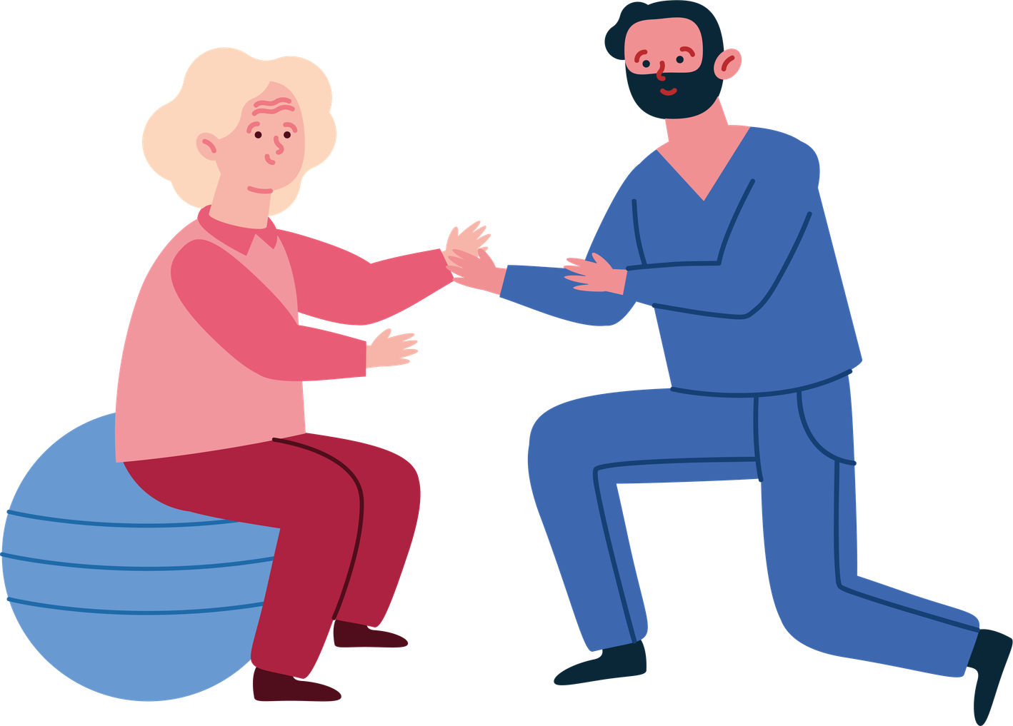
Physiotherapists contribute to
sustainable clinical practice through:
#1
Prevention
Falls Prevention
Falls in older people are a common and important problem that can have devastating consequences for individuals and their support networks.
Falls also place a huge burden on health systems.
Physiotherapists have a crucial role in the prevention of falls in older people.
Appropriately prescribed interventions can prevent falls.
There is strong evidence for the effectiveness of exercise in the prevention of falls in older people.

Slide 16


Physiotherapists contribute to
sustainable clinical practice through:
#1
Prevention
Pelvic Health Management
Rehabilitation and education, both prepartum and postpartum, may prevent pelvic health problems.
Education and pelvic floor exercises can reduce incontinence and physiotherapy can be effective in treating pelvic pain symptoms.
Early intervention may lower the need for surgical procedures.
A combination of specific treatments such as pelvic floor muscle training, manual therapies and exercise can improve health outcomes for new mothers in the postnatal period.

Slide 17
Physiotherapists Meeting SDGs
and Delivering Sustainable Clinical Practice
5 Principles. One Goal
Patient Empowerment and Self-care
#2
Patient Empowerment and Self-care

Slide 18

Physiotherapists contribute to
sustainable clinical practice through:
#2
Patient Empowerment and Self-care
Health Promotion
Advocate for health awareness and disease prevention.
Develop tailored exercise programmes and strategies.
Reduce the risk of chronic diseases.
Improve quality of life by promoting sustained mobility and functional independence.
Encourage positive lifestyle changes such as smoking cessation, nutrition, weight management, exercise and stress reduction.
Educate patients on health promotion principles.

Slide 19
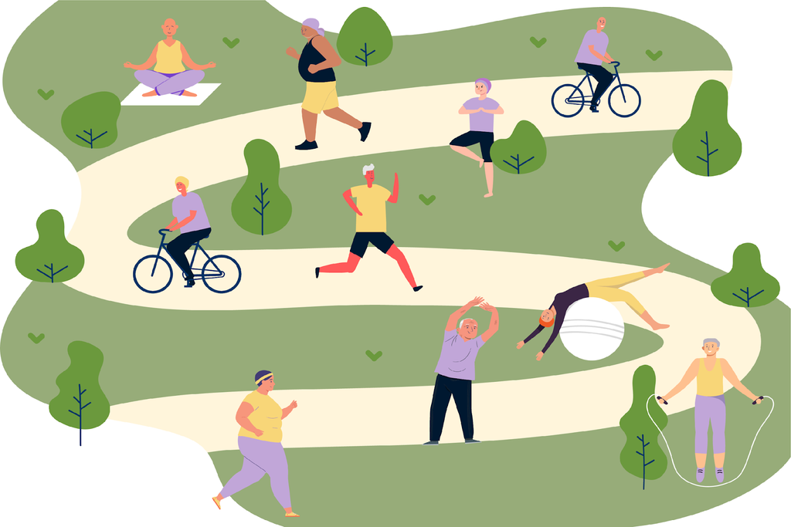
Physiotherapists contribute to
sustainable clinical practice through:
#2
Patient Empowerment and Self-care
Pain Management
Pain management reduces the environmental impact of hospital admissions, imaging, surgery, pharmaceuticals and other interventions.
Physiotherapy:
  provides patients with the tools to manage their long-term pain through a biopsychosocial approach.
  offers a non-invasive approach to managing pain through a variety of evidence-based techniques to address both chronic and acute pain.

Slide 20

Physiotherapists contribute to
sustainable clinical practice through:
#2
Patient Empowerment and Self-care
Promotion of Physical Activity
for Cancer Prevention
40% of cancers could be prevented by modifying key risk factors and implementing evidence-based prevention strategies.
Promotion of physical activity is an evidence-based strategy for primary, secondary and tertiary cancer prevention.
Encouraging participation in physical activity is a tool for health promotion.

Slide 21

Physiotherapists contribute to
sustainable clinical practice through:
#2
Patient Empowerment and Self-care
Pulmonary rehabilitation and COPD management
Chronic Obstructive Pulmonary Disease (COPD) poses a significant global health burden, with the overall burden projected to increase.
Physiotherapy has a crucial role in managing COPD and other lung conditions through exercise training, breathing techniques and pulmonary rehabilitation which improves dyspnoea, exercise capacity and health related quality of life.
Physiotherapists can consider green inhaler options when prescribing or recommending for prescribing.

Slide 22

Physiotherapists contribute to
sustainable clinical practice through:
#2
Patient Empowerment and Self-care
Cardiovascular Rehabilitation
Physiotherapists design and supervise individualised exercise programmes to improve cardiovascular fitness, endurance, muscle strength and flexibility and provide a safe progression of physical activity.
Physiotherapists support recovery, improve quality of life and reduce the risk of future cardiac events through:
  Exercise prescription and supervision.
  Risk factor modification and education.

Slide 23

Physiotherapists contribute to
sustainable clinical practice through:
#2
Patient Empowerment and Self-care
Unique Role in Weight Management
Physiotherapists are involved in lifestyle interventions and overall health promotion.
Physiotherapists:
  promote physical activity.
  prescribe exercises.
  address barriers to movement such as breathlessness and musculoskeletal pain.
  emphasise a holistic approach.
  focuson improving overall health and helping patients to adopt healthier lifestyles.

Slide 24
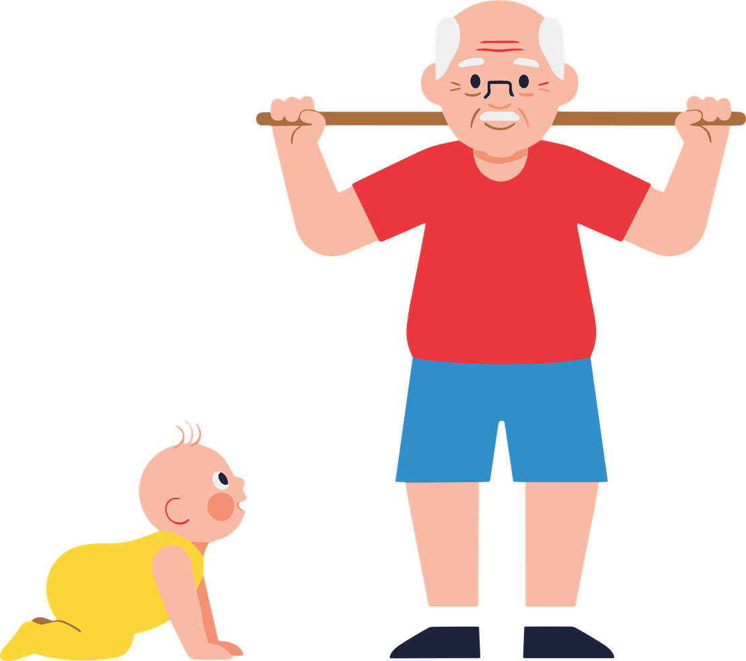
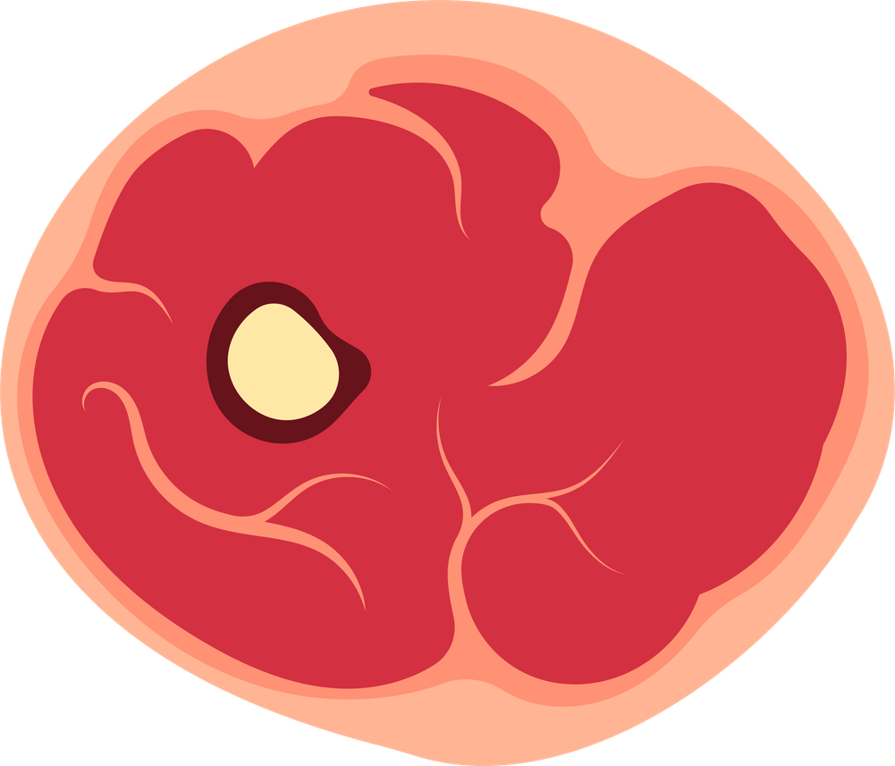
Physiotherapists contribute to
sustainable clinical practice through:
#2
Patient Empowerment and Self-care
Sarcopenia Management
Physical activity and exercise is recommended to maintain and improve muscle mass, muscle strength, physical performance and function.
Evidence suggests that an ideal physical activity programme for patients with low muscle mass should be personalised and multimodal, incorporating muscle strengthening, aerobic exercise and balance control programmes.

Slide 25
Physiotherapists Meeting SDGs
and Delivering Sustainable Clinical Practice
5 Principles. One Goal
Lean Service Delivery
#3
Lean Service Delivery

Slide 26
Physiotherapists contribute to
sustainable clinical practice in:
Primary Care
#1
Prevention
#2
Patient Empowerment and Self-care
#3
Lean Service Delivery
Physiotherapists in Primary Care provide a comprehensive, interdisciplinary, patient centred and community-oriented approach, that supports first-contact, accessible, continuous, comprehensive, and coordinated person-focused care.
Physiotherapists are important providers of quality health care within the primary care team, providing services for individuals and populations to develop, maintain and restore maximum movement and functional ability throughout the lifespan.

Slide 27
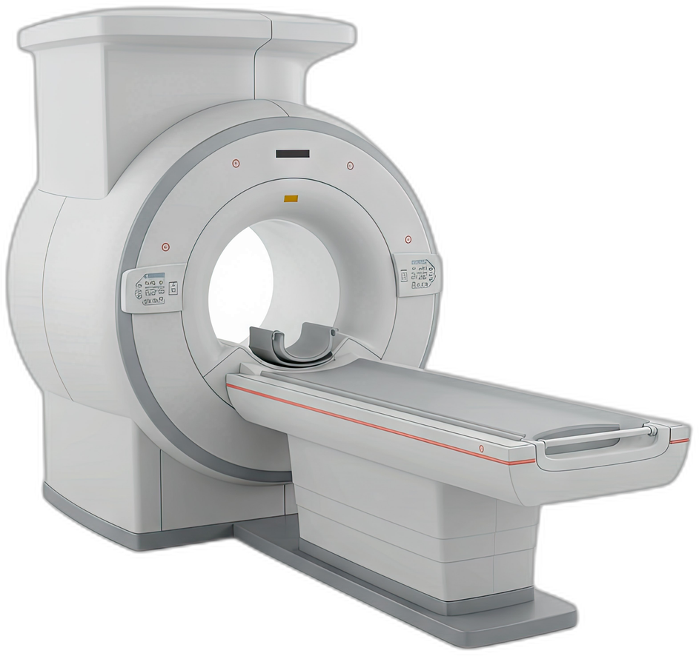
Physiotherapists contribute to
sustainable clinical practice by:
#3
Lean Service Delivery
Avoiding unnecessary imaging
Unnecessary investigations are costly and can lead to other potentially unnecessary specialty consultations and invasive tests.
A reduction in low-value imaging would reduce the waste of resources and the risk of incidental findings, overdiagnosis and overtreatment facilitating appropriate and timely patient management.
When assessing the appropriateness of imaging procedures, consider the environment, safety, effectiveness and efficiency.

Slide 28
Physiotherapists contribute to
sustainable clinical practice by:
#3
Lean Service Delivery
Offering Telehealth Services
Physiotherapists can offer care via telehealth services enabling:
  better patient access to care within their local area.
  earlier discharge from secondary healthcare facilities.
  increased availability and access of services for patients and their families.
  progress toward achieving net zero emissions.

Slide 29
Physiotherapists Meeting SDGs
and Delivering Sustainable Clinical Practice
5 Principles. One Goal
Low Carbon Alternatives
#4
Low Carbon Alternatives

Slide 30
Physiotherapists contribute to
sustainable clinical practice by:
#4
Low Carbon Alternatives
Using Low Carbon Alternatives
Physiotherapists contribute significantly to sustainable practice providing low-cost and low-carbon treatments.
The WHO recognises the empowerment of patients for self-management as a foundation for sustainable healthcare. Patient empowerment for self-care is central to physiotherapy.
Self management incorporates principles of self-efficacy which enables reduced health service utilisation without compromising health.

Slide 31
Physiotherapists contribute to
sustainable clinical practice by:
#4
Low Carbon Alternatives
Promoting Active Transport
Promoting active transport such as walking and cycling which:
  contributes to a healthier lifestyle for both healthcare workers and patients.
  reduces carbon emissions.
  supports sustainable community mobility.
Integrating eco-friendly transport options into clinical practice helps build a sustainable future.
Notes:
Encouraging active transport is an essential component of a sustainable clinic. This section will highlight the importance of promoting walking, cycling, and public transport among staff and patients.

Slide 32
Physiotherapists Meeting SDGs
and Delivering Sustainable Clinical Practice
5 Principles. One Goal
Efficient Resource Use
#5
Efficient Resource Use

Slide 33

Physiotherapists contribute to
sustainable clinical practice through:
#5
Efficient Resource Use
Operational resource use
Support Recycling Efforts
Purchasing recycled products contributes to environmental sustainability by supporting recycling initiatives and minimising waste.
Reduce Demand for New Materials
Investing in recycled products significantly reduces the need for new raw materials and conserves natural resources.
Equip Physiotherapy Clinics
Physiotherapy clinics can enhance their sustainability by maintaining and servicing equipment.
Notes:
Investing in recycled products not only supports recycling efforts but also reduces the demand for new materials. Physiotherapy clinics can source equipment, furnishings, and supplies made from recycled materials, helping to close the recycling loop.

Slide 34
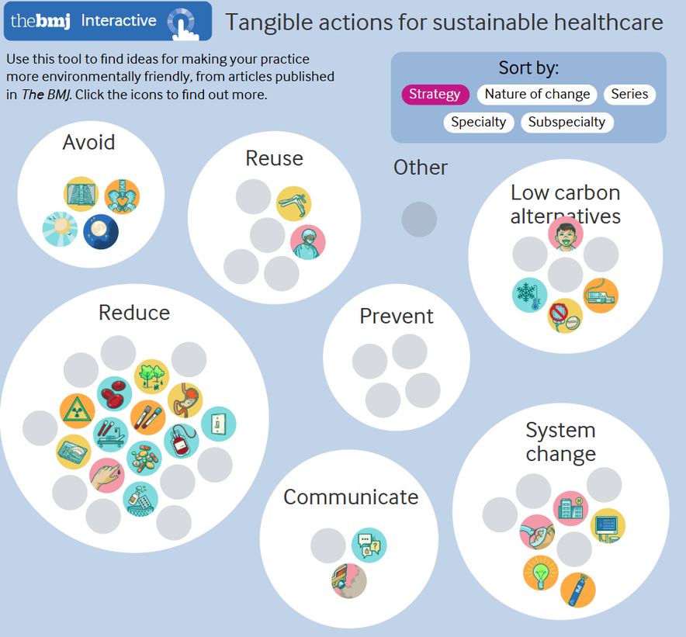
Sustainable Practice - What Can I Do?
If global healthcare were a country, it would rank 5th in the world for greenhouse gas emissions.
We must all take action to reduce healthcare emissions.
There is a user friendly at interactive tool.
Sustainable practice: what can I do? | The BMJ
Notes:
Investing in recycled products not only supports recycling efforts but also reduces the demand for new materials. Physiotherapy clinics can source equipment, furnishings, and supplies made from recycled materials, helping to close the recycling loop.

Slide 35
DESIGNING Improvement by Incorporating
the Principles of Sustainable Healthcare
Secondary driver
Change ideas
Prevention
Primary driver
Patient empowerment
Reduce activity
Outcome needed
Improve health, reduce carbon
Lean pathways
Primary driver
Low carbon alternatives
Reduce carbon intensity
Operational resource use
Mortimer-F. The Sustainable Physician
Clinical Medicine 2010, Vol 10, No 2: 110–11

Slide 36
THANK YOU!
TOGETHER THE PHYSIOTHERAPY COMMUNITY CAN MAKE A DIFFERENCE
FOLLOW US!

Slide 37
Other resources:
•European Green Deal The European Green Deal - European Commission
•Paris agreement The Paris Agreement | UNFCCC
•Event map Together the physiotherapy community can make a difference
•Taskforce on nature related financial disclosures The Taskforce on Nature-related Financial Disclosures
•Sixth Assessment Report — IPCC
•Climate Change - Our World in Data
•Systems Thinking Tools: A User's Guide
•Home | Climate Action Tracker
•Many countries have decoupled economic growth from CO2 emissions, even if we take offshored production into account - Our World in Data
•WEF_Global_Risks_Report_2025.pdf
•The Tipping Points of Climate Change — and Where We Stand | Johan Rockström | TED
•The Legacy of the Brundtland Report: Pioneering Sustainable Development - cr-rwa.org
•HSE-Climate---Strategic-Framework-Greener-Models-of-Healthcare
•Together the physiotherapy community can make a difference
•Together the physiotherapy community can make a difference
•Calculating carbon foorprint
•OPB: Salmon Wars – OPB
•Loopy
FOLLOW US!

Slide 38
Behaviour change:
How Countries Can Use Behaviour Change to Further Reduce Emissions | World Resources Institute
•Behavioural change policies can be an extremely powerful tool to make transformational shifts towards lowering greenhouse gas emissions, yet most countries are failing to use them. For example, shifting away from cars toward walking or biking is critical for a sustainable future, yet only 5 of the world’s 20 highest emitters are using their Nationally Determined Contributions (NDCs) to help catalyse this shift. This is a missed opportunity.
Environment | Focus Areas | Behavioural Insights Team
•
FOLLOW US!

